Slide 1
Regional Analysis of a Supermarket
By Team 3: Ethan Ericson, Nate Moore, Jacob Romine, and Jason Van Wieren
Notes:
Nate

Slide 2
Project Overview
Dataset: US Sample Data (Fictitious)
The goal of this project was to analyze the factors that impact product performance to predict future performance and make prescriptions for better sales practices.
Notes:
Nate

Slide 3
Hypotheses
Hypothesis 1: There exists a correlation between product performance (measured by profit), consumer segment, and product category within the superstore.
Hypothesis 2: Product returns are correlated with the factors listed below and can be used to predict product performance in a specific location by pinpointing areas with high or low returns.
Our Hypotheses predict that the factors influencing product performance are:
Region
State
Segment
Category
Returned Status

Slide 4
Methods
We split our analysis up by region.
Within each region, we explored the total profits of categories of products, separated by customer segment. We also investigated the levels of returns within each of our region.
We constructed a machine learning model to predict product profit based on customer segment, category, and returns.
Notes:
Ethan

Slide 5
National Analysis
Notes:
Ethan

Slide 6
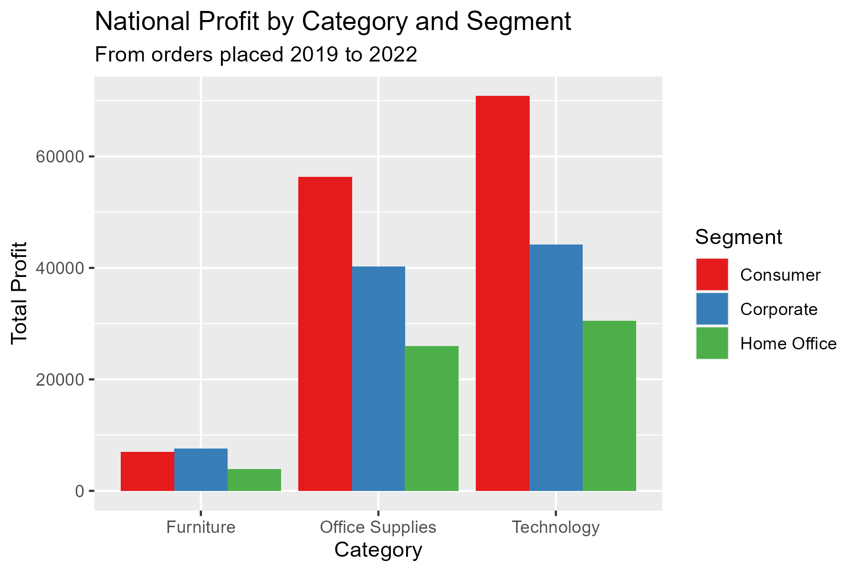
National Profit
Graph shows the total profits of a certain category, split by buyer segment.
Furniture has the lowest profits altogether, while Office Supplies and Technology are similar to each other.
On the surface, it appears that furniture is not preforming well across all customer segments
Source: US Superstore - Sample
Notes:
Ethan

Slide 7
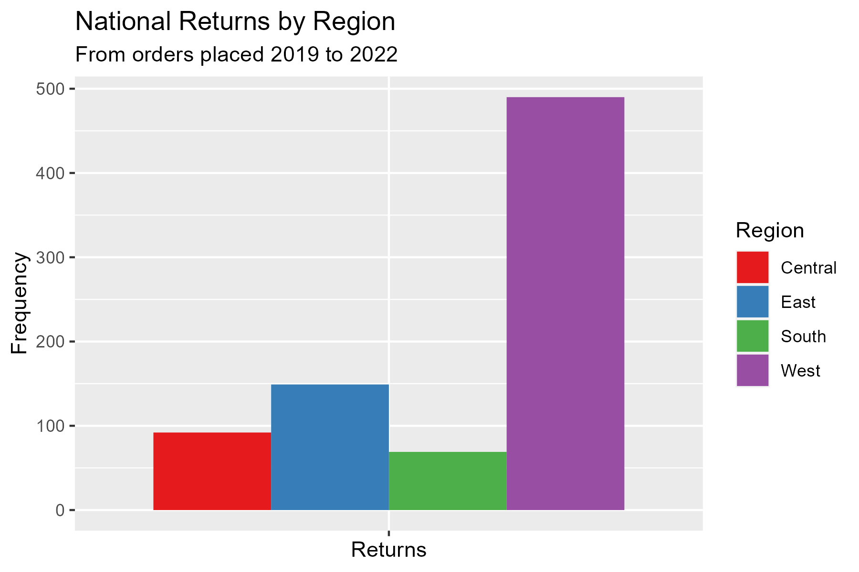
National Returns
Graph shows the total amount of returns in each of the regions.
West region has high number of returns.
South and Central regions have low number of returns.
Source: US Superstore - Sample
Notes:
Ethan

Slide 8
Southern Analysis
Notes:
Ethan

Slide 9
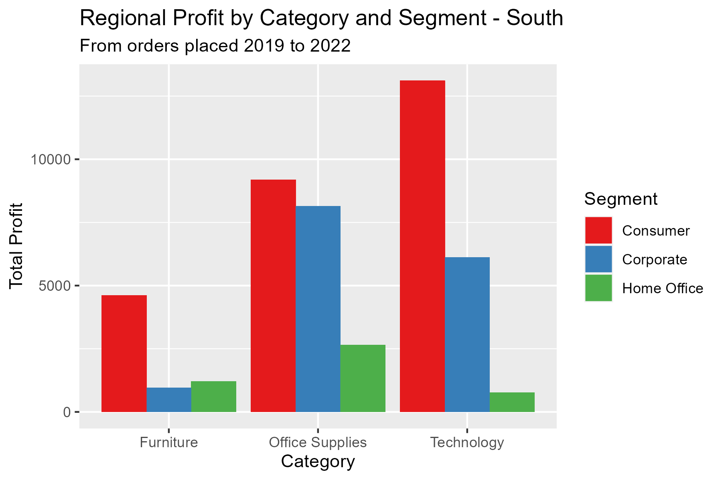
Southern Profit Analysis – Category and Segment
Consumers represent the most profitable segment to sell products to.
The furniture category is the worst preforming out of the three the company sells.
So, category and segment affect the profit the business earns.
Source: US Superstore - Sample
Notes:
Etahn

Slide 10
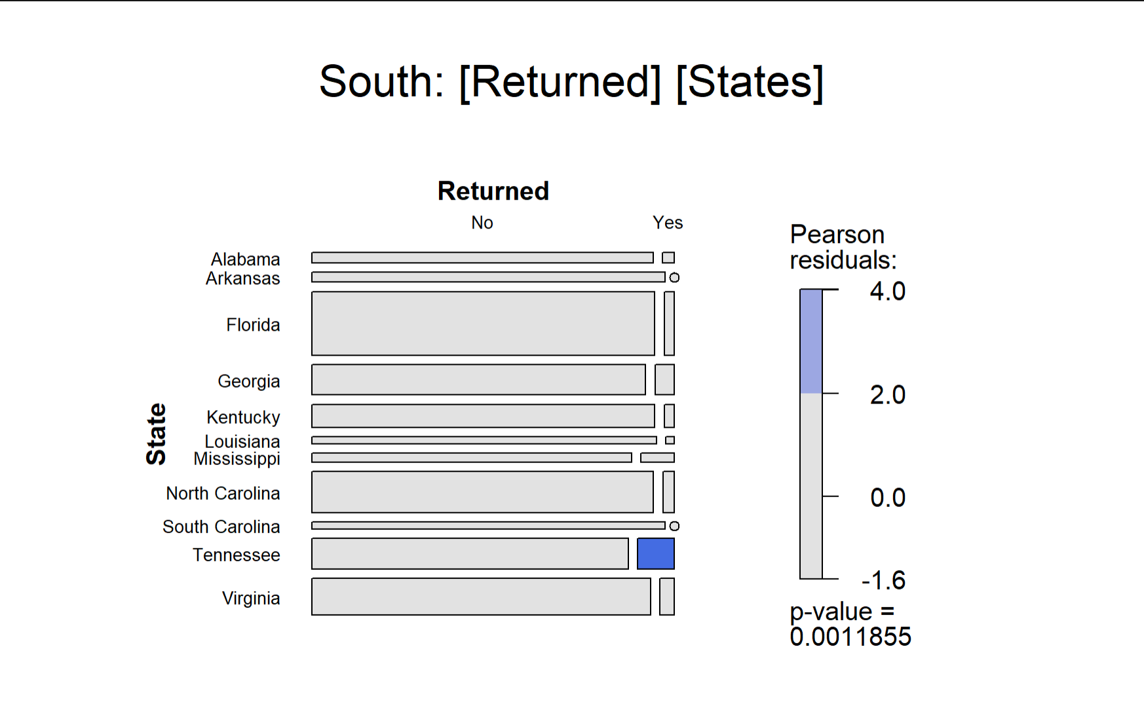
Southern Return Analysis - States
P values measure probability of attaining the observed results given the null hypothesis is true.
A residual measures how far away an observation is from an expected value give the null hypothesis is true.
Tennessee has a high positive residual for returns, which indicates higher than expected returns.
Source: US Superstore - Sample
Notes:
Ethan

Slide 11
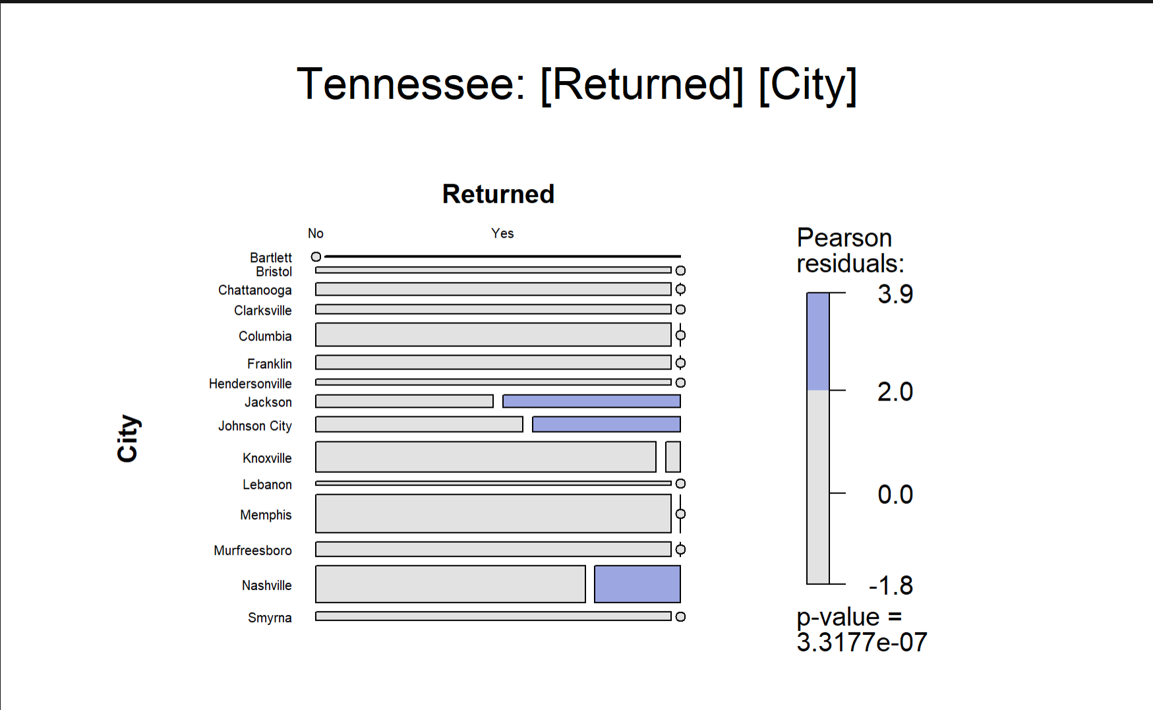
Southern Return Analysis – Tennessee Cities
Note the p-value of 0
Nashville, along with Jackson and Johnson City have high residuals, so there must exist a strong relationship between returns and cities within Tennessee.
Source: US Superstore - Sample
Notes:
Ethan

Slide 12
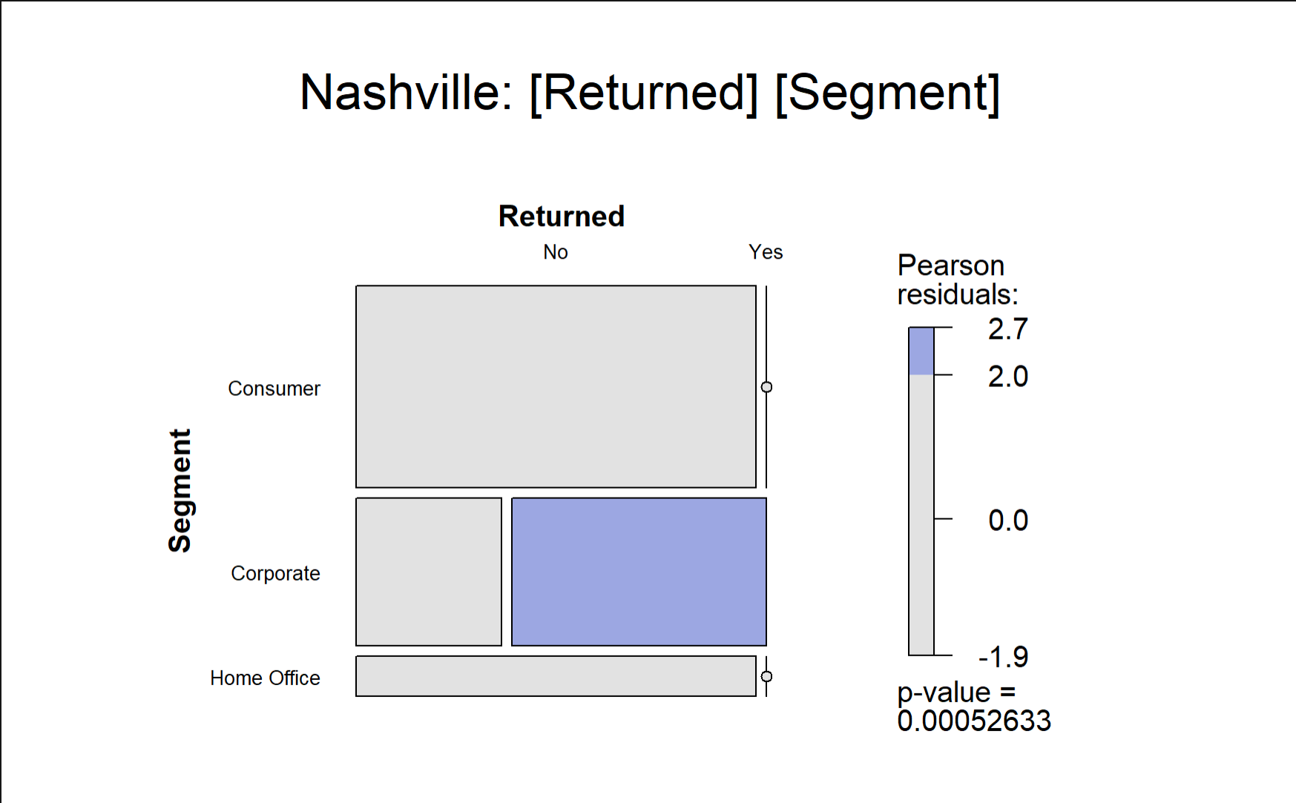
Southern Return Analysis – Segments within Nashville
Note the p-value is < 0.05.
Large residuals in the Corporate segment indicate higher than expected returns from corporate buyers.
Nashville corporations are likely are driving the higher than expected returns in Tennessee.
Source: US Superstore - Sample
Notes:
Ethan

Slide 13
Central Analysis
Notes:
Jason

Slide 14
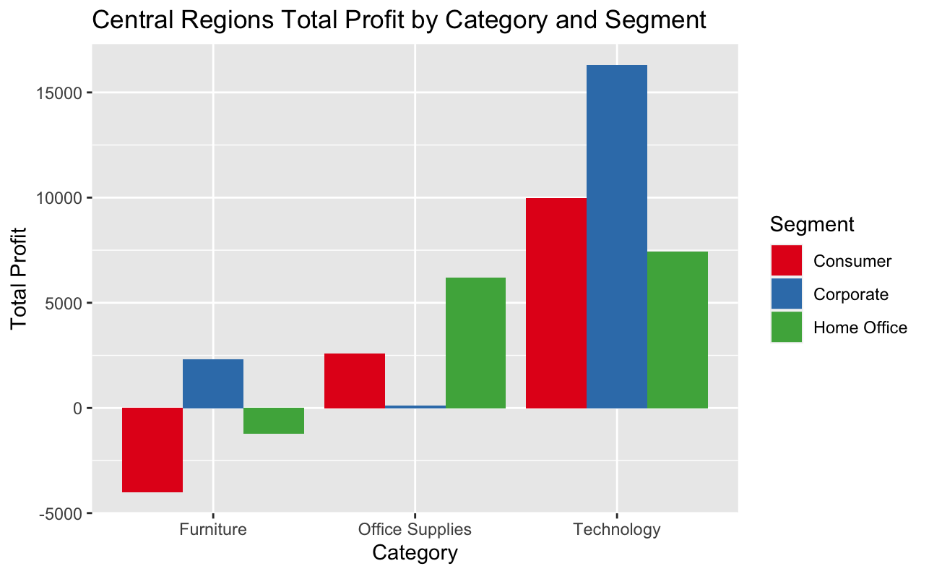
Central Profit Analysis – Category and Segment
Furniture is being sold at a loss on average.
Technology by far the most profitable category.
Corporate is the most profitable segment.
This shows both category and segment play a role in profits in the central region.
Source: US Superstore - Sample
Notes:
Jason

Slide 15
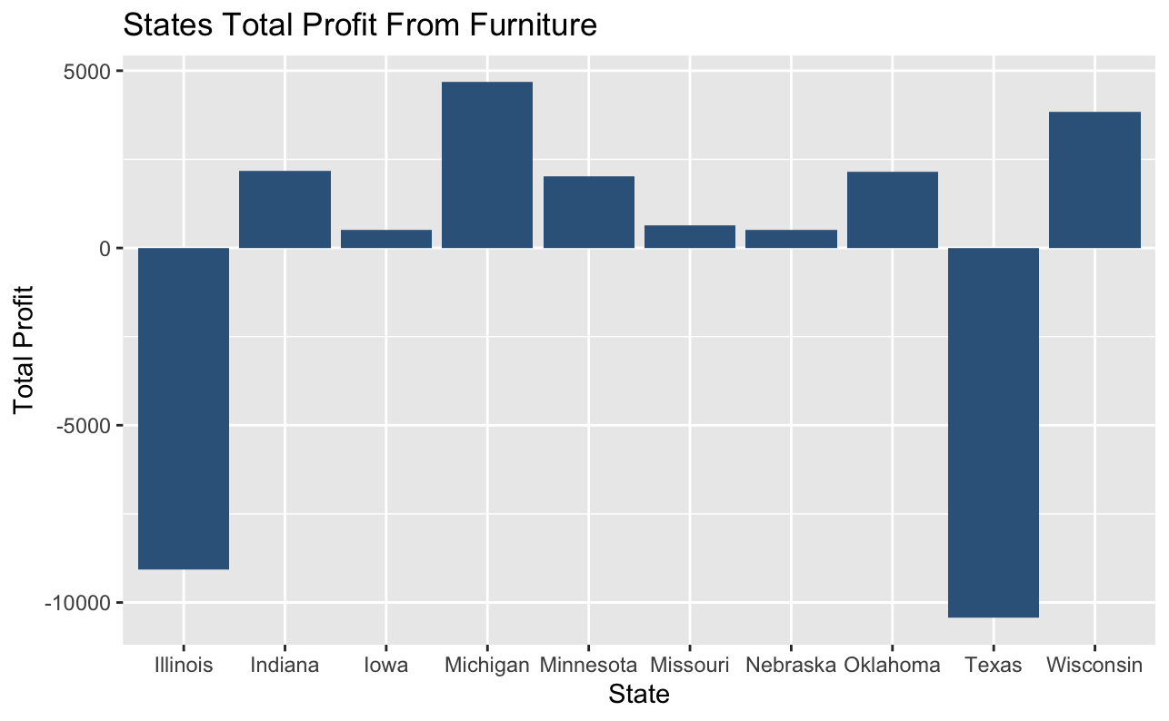
Central State Profit Analysis – Furniture
Illinois and Texas stand out as outliers in the data.
Most other states making profit of less than $2,500.
Texas and Illinois alone make profits from furniture in the central region a deficit.
(Kansas and South Dakota not included)
Source: US Superstore - Sample
Notes:
Jason

Slide 16
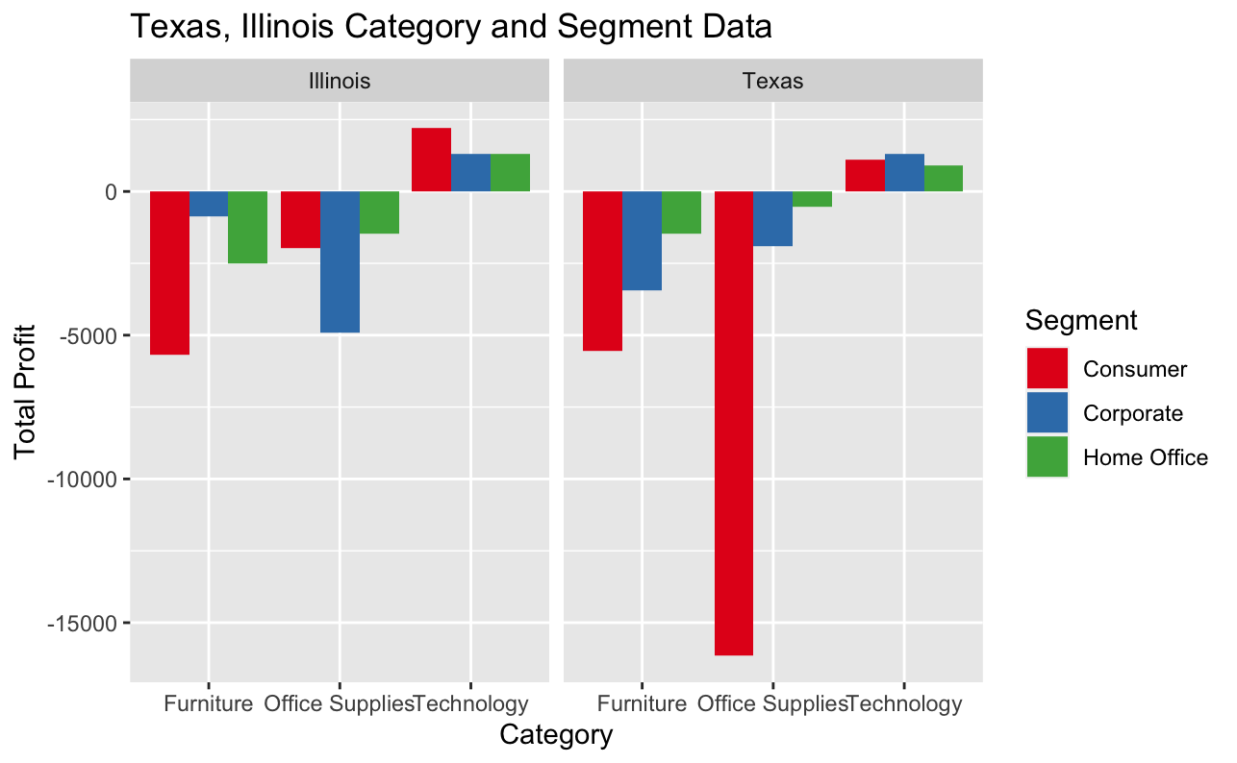
Texas & Illinois Profit Analysis – Category & Segment
Both furniture and office supplies being sold at a loss in all segments in both states
Technology still the most profitable category
Source: US Superstore - Sample
Notes:
Jason

Slide 17
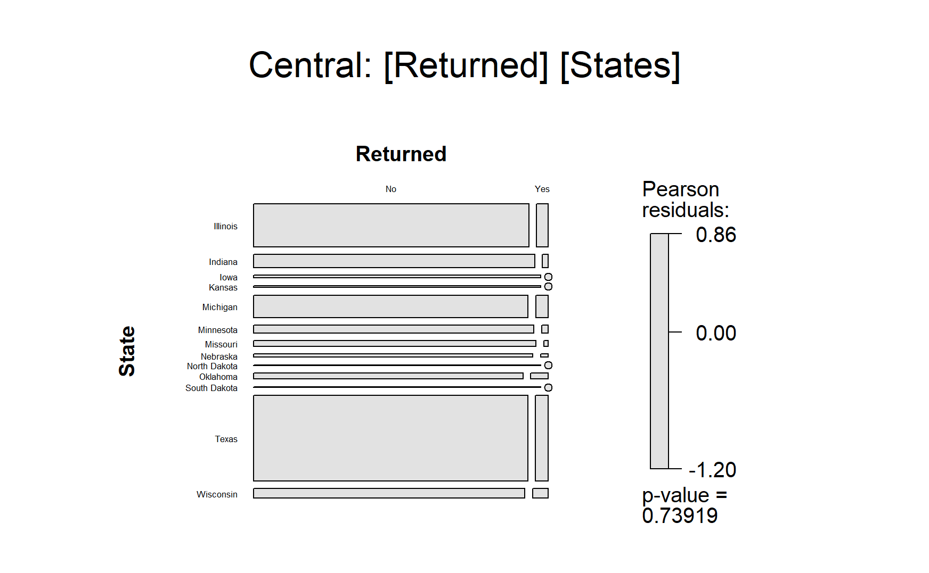
Central Return Analysis - States
Note the high p-value.
Few states have high residual values meaning what was observed was mostly expected.
Source: US Superstore - Sample
Notes:
Jason

Slide 18
Western Analysis
Notes:
Nate

Slide 19

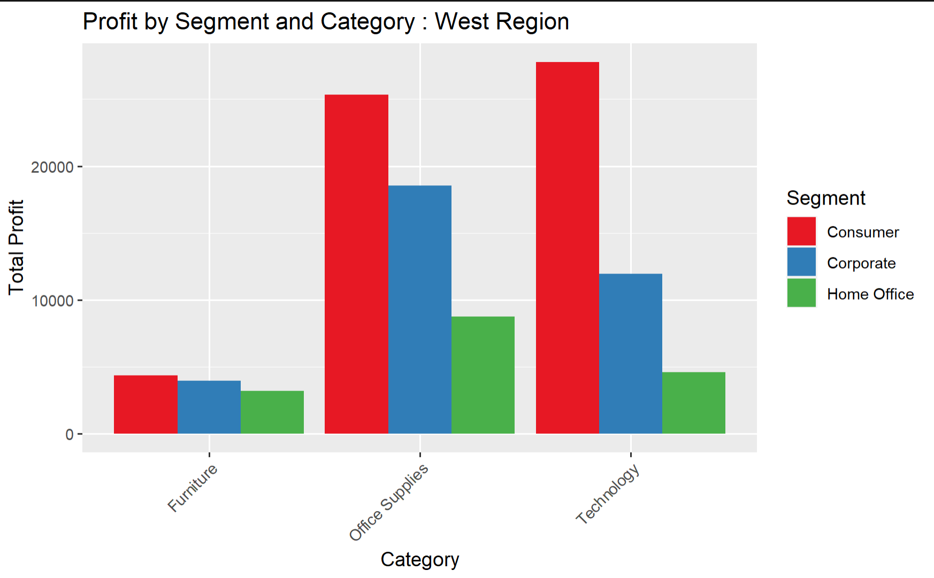
Western Profit Analysis - Category and Segment
As you can see, Furniture seems to be overall one of the least profitable
Consumers make up majority of the volume in profit
Corporate and home office have similar interest in products purchased
Source: US Superstore - Sample
Notes:
Nate

Slide 20
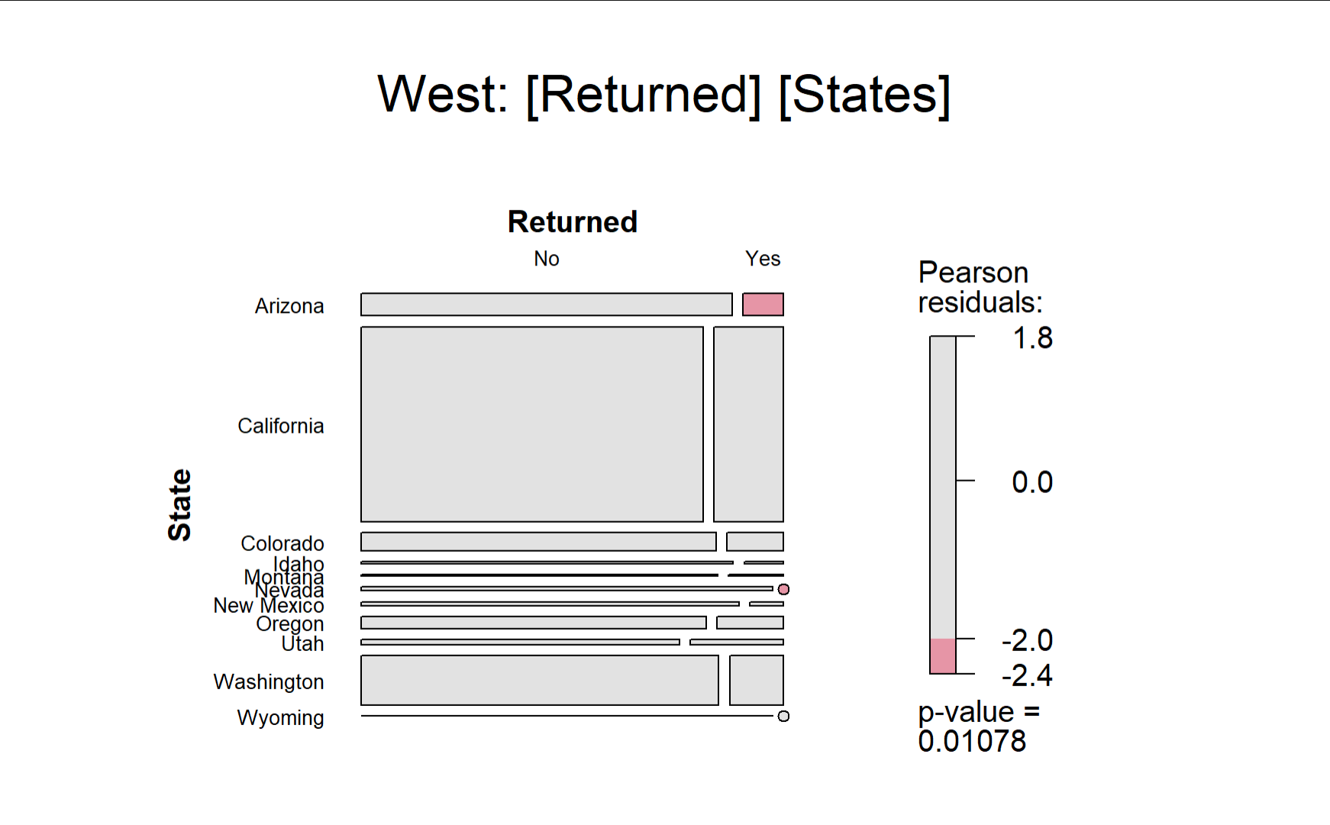
Western Return Analysis - States
Note p-value < 0.05
California accounts for most of the returns
Negative residuals in Arizona and Nevada, indicating more products kept than expected.
Source: US Superstore - Sample
Notes:
Nate

Slide 21
Eastern Analysis

Slide 22
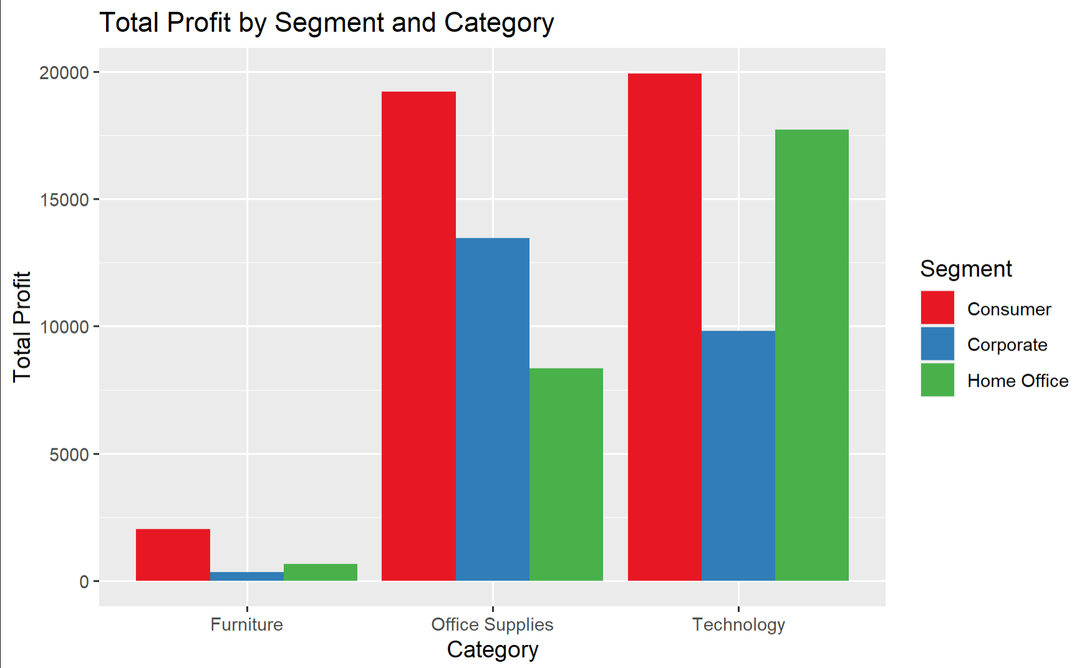
East Total Profit by Segment and Category
Consumer is the most profitable by far, except in technology, where home office is profitable as well.
Furniture is by far the worst, almost losing profit with corporate buyers.
Source: US Superstore - Sample
Notes:
Jacob

Slide 23
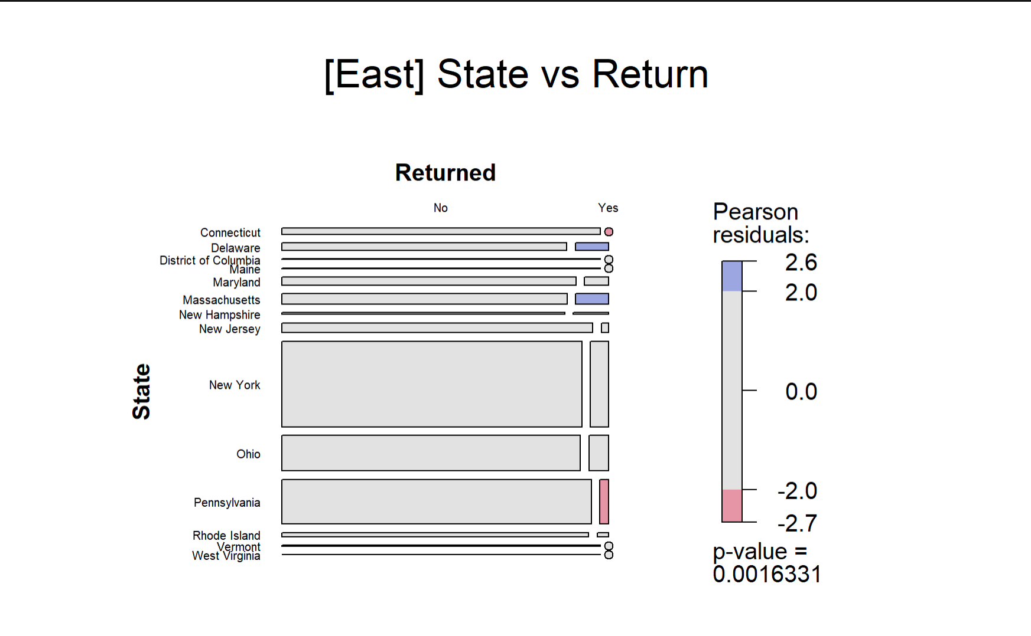
East State versus Return Mosaic Plot
New York (NYC specifically) accounts for most of the returns
Negative residuals in Connecticut and Pennsylvania.
Positive residuals in Delaware and Massachusetts.
Source: US Superstore - Sample
Notes:
Jacob

Slide 24
Machine Learning
Notes:
Ethan

Slide 25
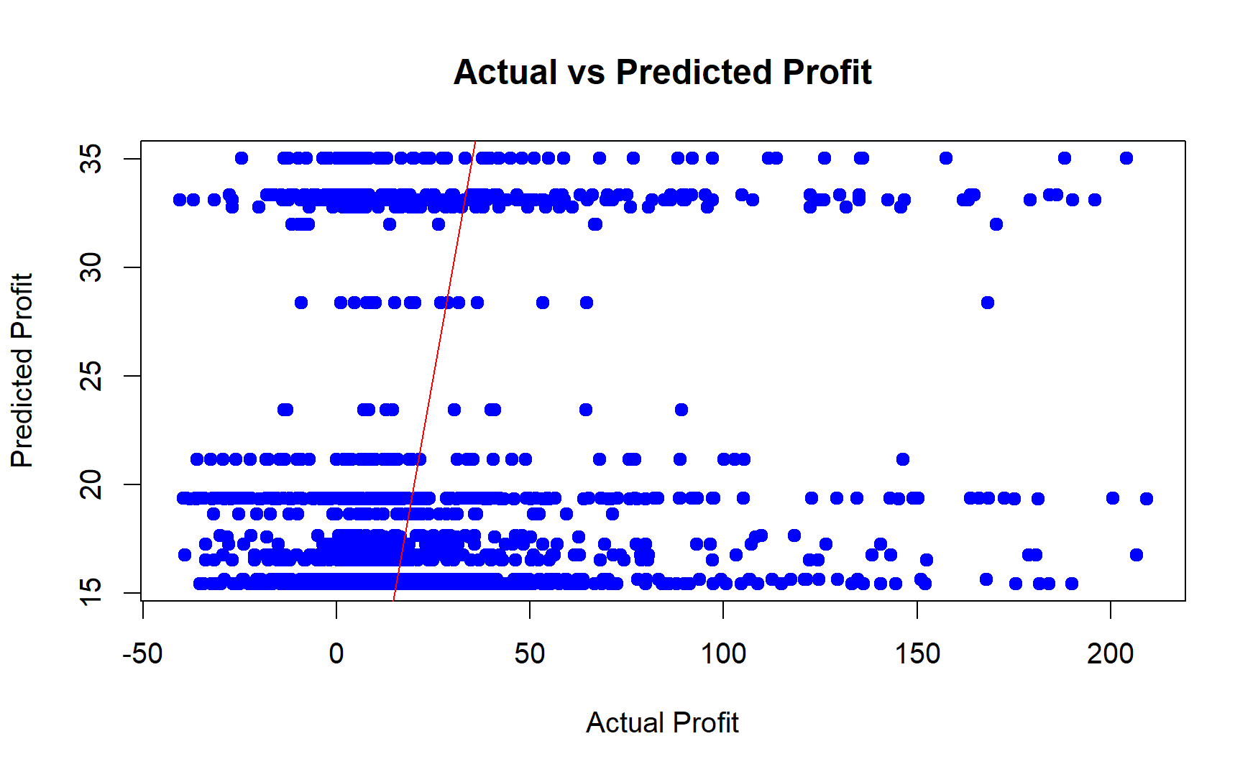
Machine Learning Model
Correlation plot of predicted profits vs the actual profits based on Segment, Category, and Return Status
We tried to use Target Guided Ordinal Encoding to account for the use of only categorical variables, but we still failed to accurately predict profits.
Used Random Tree Regression model.
MSE: 1211.12 (Very high = Inaccurate)
Source: US Superstore - Sample
Notes:
Ethan

Slide 26
Conclusion

Slide 27
Overall Findings
We found that furniture under-preformed in all of our regions; thus, the company should re-evaluate whether it sells furniture or not.
Continued sale of furniture will not produce large dividends.
Product returns are influenced by region, state, and city overall.
These observations have the implication that the company should divert resources away from furniture sales towards office supplies and technology, and that the company should investigate the levels of returns within each regional location.
Notes:
Jason

Slide 28
Challenges
We found that due to our data being fictitious it was hard to find any incredibly conclusive evidence that time and the data points correlated.
We found very few publicly available datasets that had enough data to conduct a Exploratory Data Analysis split among 4 people. We settled for a fictitious dataset which had its own problems.
Notes:
Jacob

Slide 29
References
Bhalla, D. (n.d.). A complete guide to Random Forest in R. ListenData. https://www.listendata.com/2014/11/random-forest-with-r.html
Friendly, M. (2023, August 21). Permuting variable levels. R-Packages. https://cran.r-project.org/web/packages/vcdExtra/vignettes/mosaics.html
Helsloot, R. (2020, November 8). Change the size of labels in mosaic function, R. Stack Overflow. https://stackoverflow.com/questions/61579713/change-the-size-of-labels-in-mosaic-function-r
Martin, S. (2023, January 18). Where Can I Find Superstore Sales? - On a Tableau Quest... - Confluence. Datawonders.atlassian.net. https://datawonders.atlassian.net/wiki/spaces/TABLEAU/blog/2022/10/26/1953431553/Where+Can+I+Find+Superstore+Sales#Workbooks-and-Data-Sources
Mudadla, S. (2023, April 27). Target guided ordinal Encoding with Example. Medium. https://medium.com/@sujathamudadla1213/target-guided-ordinal-encoding-with-example-450323fea78e
STHDA. (n.d.). Chi-Square Test of Independence in R - Easy Guides - Wiki - STHDA. Www.sthda.com. http://www.sthda.com/english/wiki/chi-square-test-of-independence-in-r
Notes:
Ethan

Slide 30
Questions?
Notes:
Ethan

